Slide 1
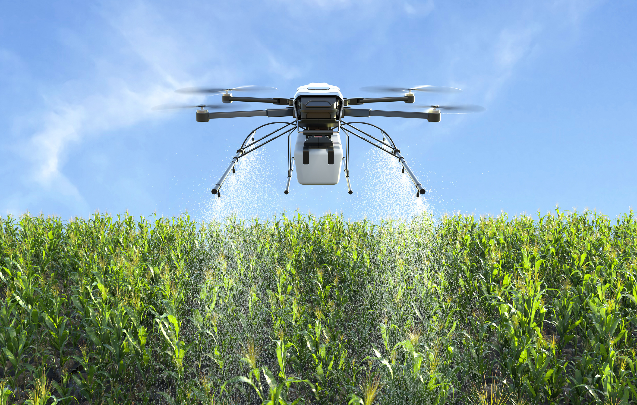
Game of Drones
Multi-UAV Pursuit-Evasion Game With Online Motion Planning by Deep Reinforcement Learning

Slide 2
Introduction
UAV : Unmanned Aerial Vehicle
Swarm of UAVs is used for a pursuit - evasive game in the environment filled with obstacles.
It highlights the development of a Pursuit=Evasive Scenario (PES) framework using a Unity 3-D Physics Engine to simulate the environment and allowing Quadcopters to interact dynamically.
Unmanned Swarm Systems are necessary for cooperative and comparative tasks since a single inadequate for complex missions due to limitations.
Authors referenced that exsiting methods for target pursuit and obstacle avoidance are inadequate in physical constraints and dynamic environments.

Slide 3
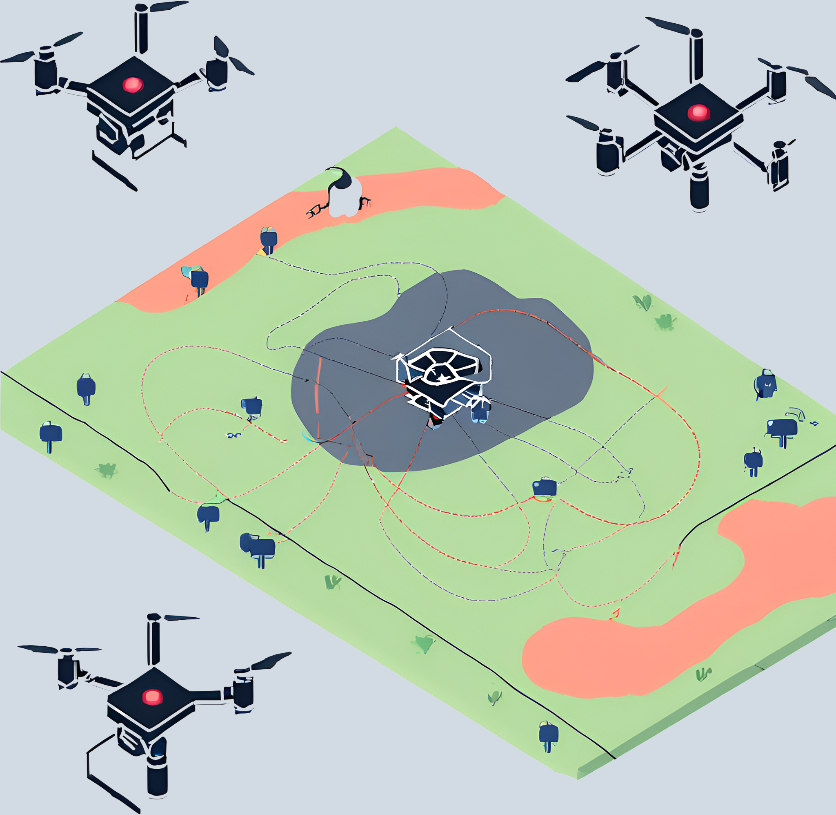
6. Paper positions Deep reinforcement learning as a suitable approach for real time trajectory planning and outlines several multi-agent DRL methods , including MADDPG and its variants
7. Authors aim to fill the lack of scalable network structures for damaged swarm systems.

Slide 4
SIMULATION
Pursuit-Evasion Scenario (PES)
01
02
03
04
Allows realistic simulation of quadcopter agents in an urban environment , facilitating real time interaction and data collection
Includes features like Damage Simulation upon collision with obstacles and ability to easily generate new urban environments by adjusting parameters.
A Simulator Framework
Integrates Unity 3-D physics engine with DRL framework

Slide 5
PROBLEM STATEMENT
The multiple Quadcopters pursue a target in an urban environment with obstacles. Game begins with Quadcopters and the target placed at random initial positions . Quadcopter agents aim to capture the target by coming within a 2 meter radius for 5 consecutive time steps.
Objectives: The primary objectives are to achieve successful capture while avoiding collisions with obstacles and other UAVs.

Slide 6
Existing Methods and Their Limitations
Target Pursuit Methods: Existing methods for target pursuit often rely on simple heuristics or predefined strategies that do not adapt well to dynamic and complex environments.
Obstacle Avoidance: Traditional obstacle avoidance techniques may not scale well with the complexity of urban environments or the number of agents involved.
Lack of Physical Constraints: Many current methods do not consider the physical constraints of UAVs, such as limited battery life, aerodynamic properties, and collision dynamics.

Slide 7

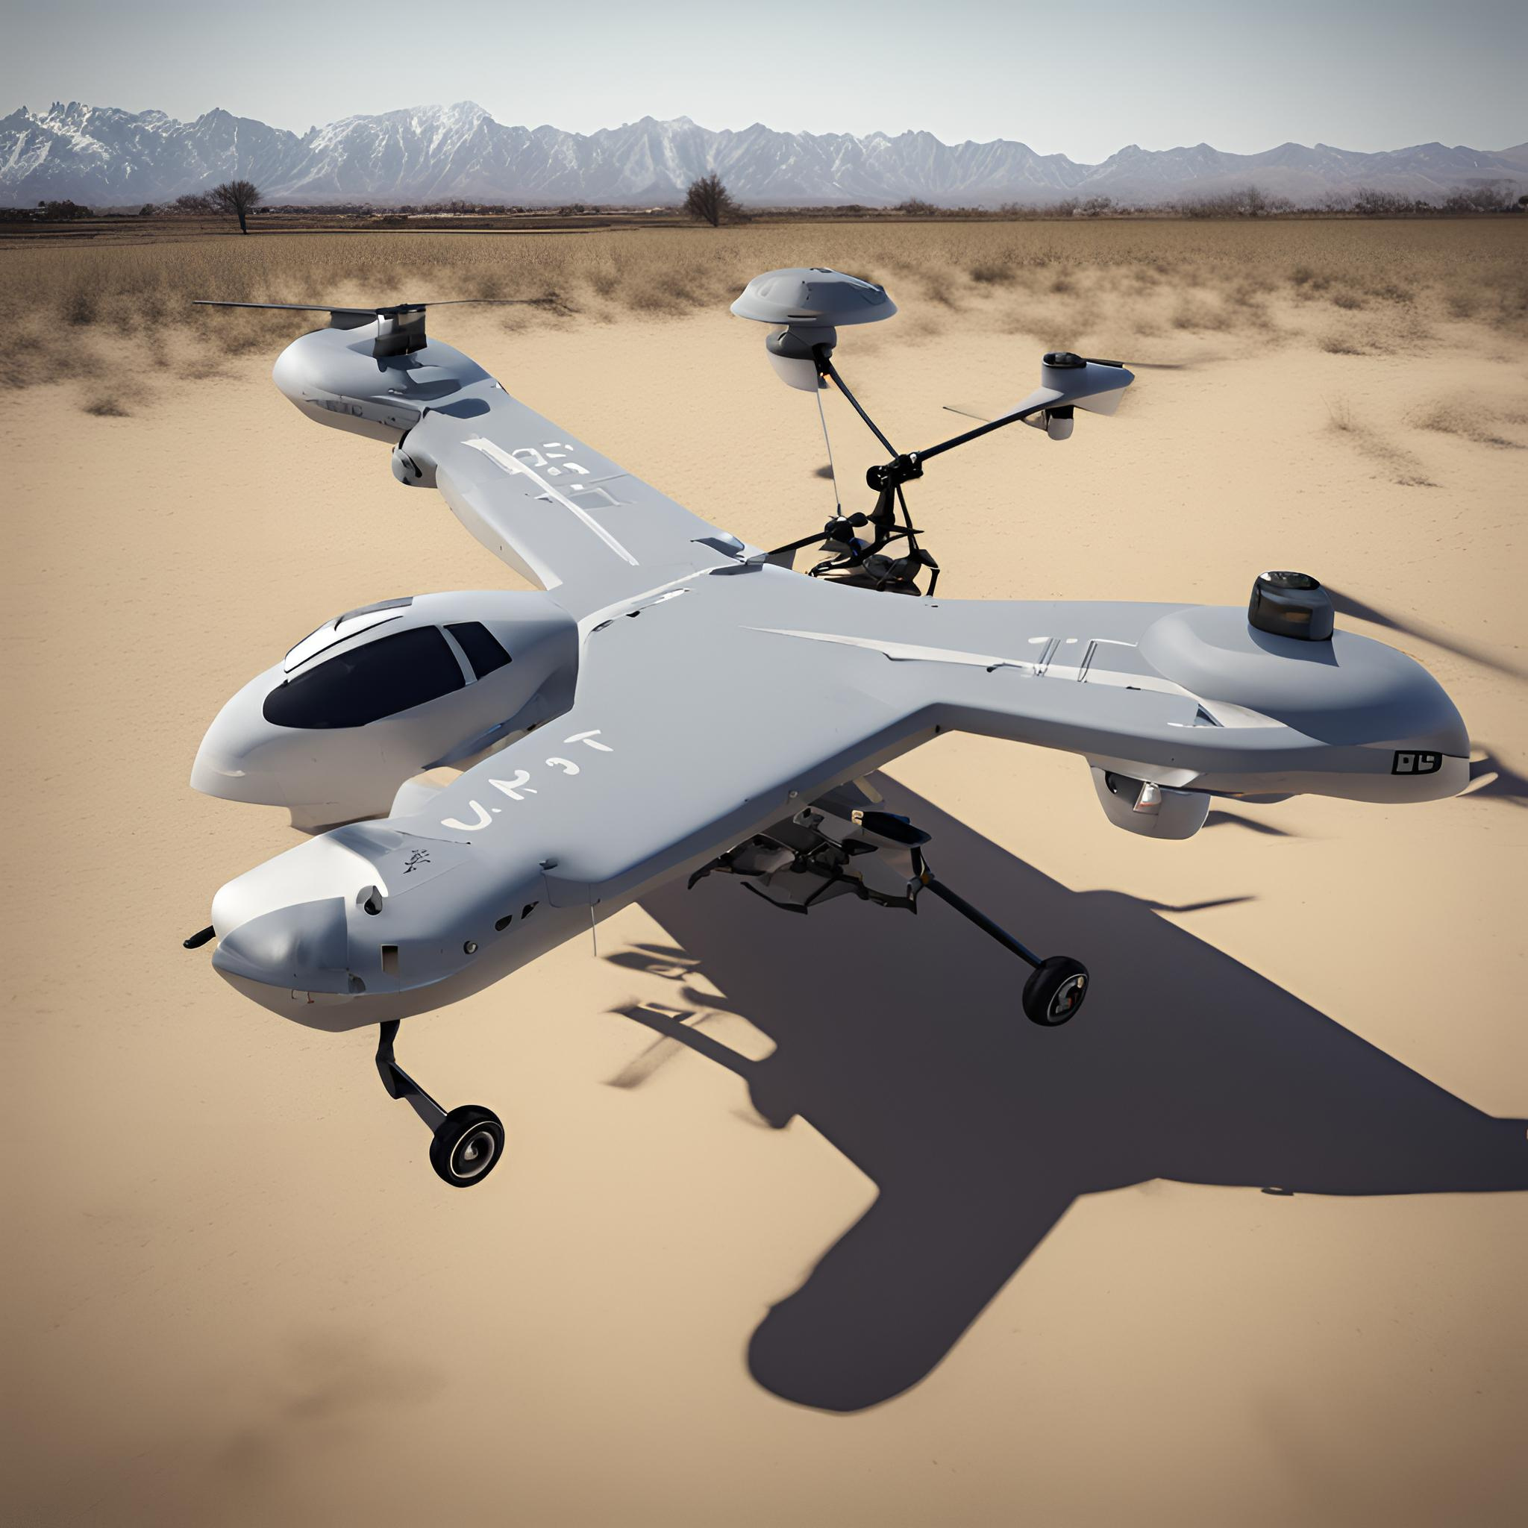
Quadcopter Model
Degrees of Freedom: 6 DoFs i.e. 3 Translational and 3 Rotational.
PID Controller : Proportional -Integral- Derivative Controller, used to achieve accelerations and control UAVs Movements in horizontal plane.

Slide 8
Integration with DRL: CBC-TP Net integrates DRL with a target prediction network to enhance decision-making capabilities. It predicts the target's future movements, allowing UAVs to plan their trajectories more effectively.
Markov Game Framework: The model operates within the framework of a stochastic Markov game, extending Markov decision processes (MDPs) to multiple agents. Each agent aims to maximize its expected reward by optimizing its policy.
Coronal Bidirectionally Coordinated with TP Net (CBC-TP Net)

Slide 9
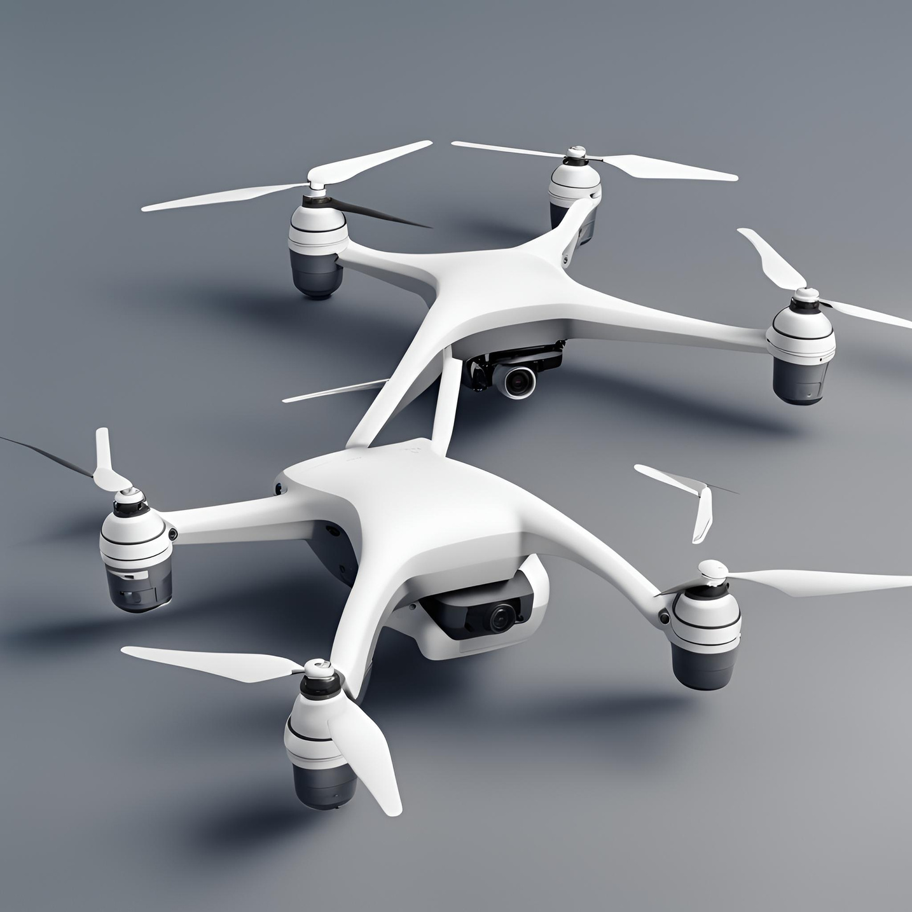
Problem Formulation
State, Action, Reward: Each agent observes the state of the environment, takes an action based on its policy, and receives a reward. The objective is to find the optimal policy that maximizes the total expected reward over time.
Coordination and Prediction: The CBC-TP Net coordinates the actions of multiple UAVs and uses the target prediction network to anticipate the target's movements, improving the overall efficiency and effectiveness of the swarm.

Slide 10
Hierarchical Multiagent Gradient-Descent Algorithm
Gradient Descent for Policy Optimization: The hierarchical algorithm uses gradient descent to update the policies of the UAVs. By structuring the updates hierarchically, the algorithm can handle the complexity of multiple interacting agents.
Efficiency and Performance: The hierarchical approach improves the learning efficiency and performance of the multiagent system, allowing it to scale to larger swarms and more complex environments.

Slide 11
Experimental Setup
Comparative Analysis: The performance of CBC-TP Net is compared against baseline models, demonstrating its superiority in both normal and damaged conditions
Simulated Urban Environment: The experiments are conducted in a simulated urban environment with various obstacles and dynamic elements.

Slide 12
Results
Performance Metrics: Key performance metrics include the capture rate, time to capture, and the ability to avoid collisions.
Damage Resilience: The experiments show that CBC-TP Net maintains high performance even when some UAVs are damaged, highlighting its robustness and adaptability.

Slide 13
Conclusion and Future Work
Summary of Contributions
Future Directions
PES Framework: The development of the PES framework for realistic simulation of pursuit-evasion scenarios.
CBC-TP Net Model: The integration of DRL with a target prediction network, resulting in improved decision-making and coordination among UAVs.
Experimental Validation: Demonstration of the model's superior performance in various conditions.
Scalability and Robustness: Further research will focus on enhancing the scalability and robustness of the model, addressing challenges related to larger swarms and more diverse environments.
Real-World Applications: Potential future work includes applying the model to real-world scenarios, further testing and refining its capabilities in practical applications.

